Slide 1
Power generation Recomendadtion
Professor : Murali Shanker Presenter : Pavan Chaitanya B

Slide 2
Contents
Problem
Data Description
Analysis
Techniques
Findings
Conclusion and Discussion
Interpretation
Summary

Slide 3
Problem
Analyzing a Data(EIA-923) that is present in Public Utility Data Liberation(PUDL) project
Providing recommendations of the findings regarding Power Generation in the USA.

Slide 4
Data Description
While Analysing the data the following are found
1)Columns Redundancy.
Similar data is present in multiple Columns
Eg) fuel_type_code_pudl, fuel_group_code etc.
2)Unnecessary Colums.
There are some columns that are not required for compution
Eg) report_date, data_maturity
3)Missing Values in the Columns.
There are significant missing values present in the Columns.
Eg) secondary_transportation_mode_code, mercury_content_ppm etc

Slide 5
Data description
While solving the problem in regarding to data the following are done:
1)Reading the data.
2)Randomly sampling about 2% of overall data.
3)Computing out the Missing Values that are present in data.
4)Removing the Unnecessary variables that are present.
5)Data Partition of the data[75% training].
6)Choosing the numeric variables and scaling them(fuel_recieved_units, fuel_mmbtu_per_units, fuel_cost_per_mmbtu,
ash_content_pct) etc

Slide 6
Techniques
Clustering the data
The techniques that i followed for solving is:
Kmeans
For finding the best ‘k’ using the silhouette method.
Hierarchial Clustering
Dendrogram for visualizing the clusters

Slide 7
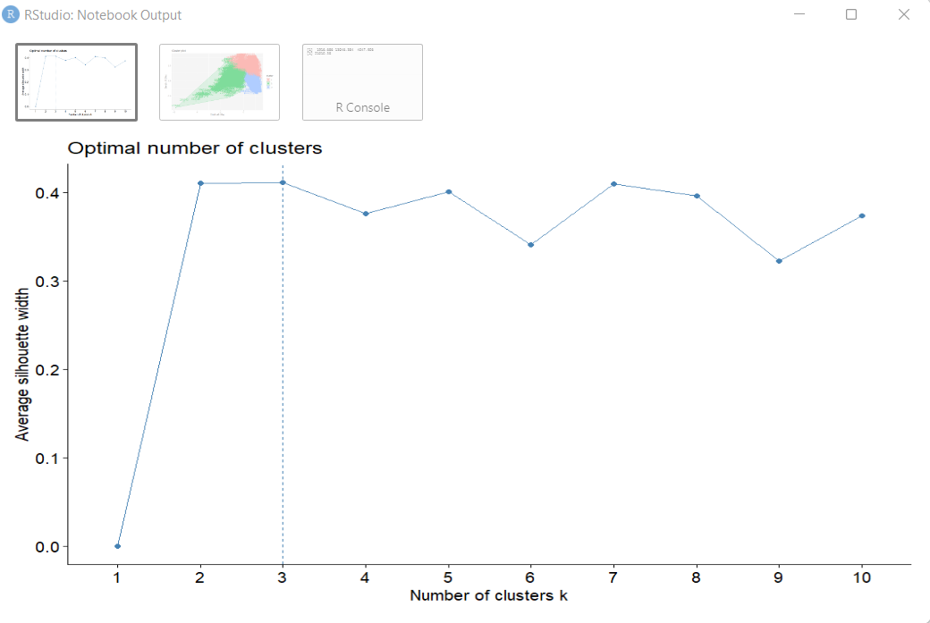
FindiNGS
Using the silhouette method we have found the best ‘K’.

Slide 8
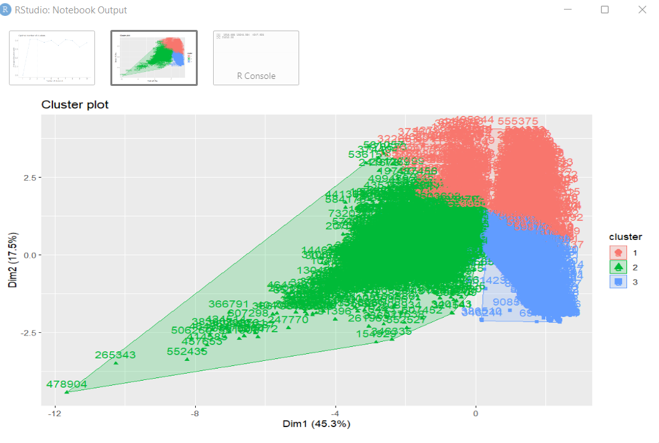
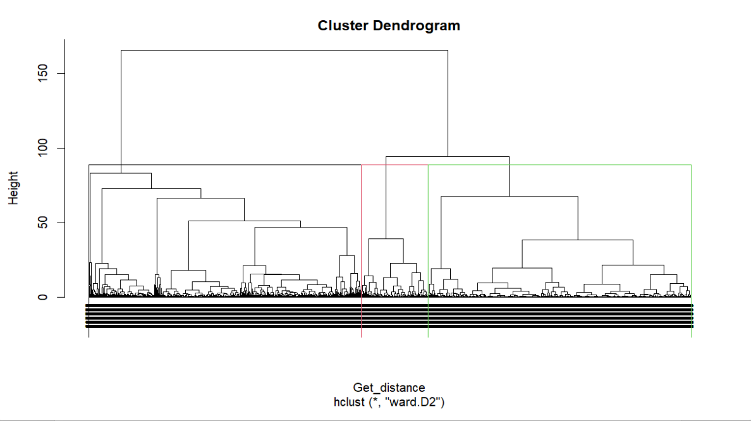
Findings
Plotting using fviz_cluster().
Plotting using the dendrogram.

Slide 9
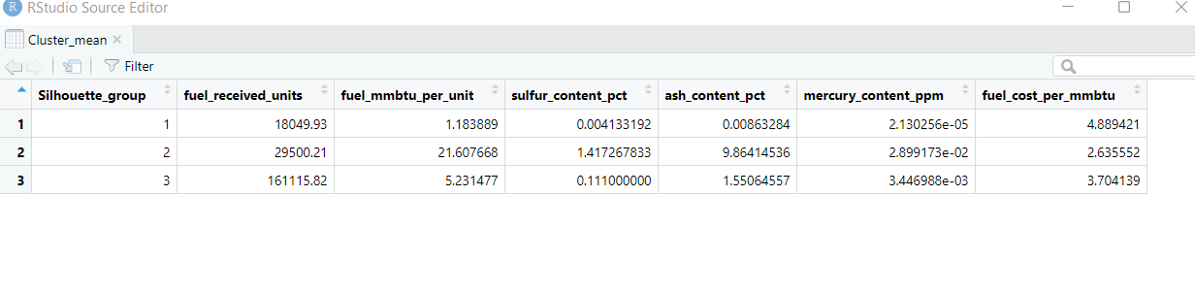
Conclusion and discussion
Now we can intrept the 3 clusters formed .

Slide 10
Interpretation
Cluster 1
Cluster 2
Cluster 3
The power plants present in this cluster recieves fuel of (18049.93) units which is low compared to other plants.
As they are receiving low fuel their heat content in fuel(fuel_mmbtu) is also low (1.183889).
The fuel cost per mmbtu is higher(4.889421) than all the 3 clusters formed.
The power plant present in this Cluster is not a preferred one to recommend for Us Government because of fuel cost per mmbtu.
The power Plants present in this cluster receives fuel of (29500.21) units which is slightly above the Cluster 1 but not cluster 2.
Their heat content in the fuel is very very high of 21.607668 comapared to all the 3 clusters.
The fuel cost per mmbtu is lower(2.635552) than all the 3 clusters formed.
The power plant present in this Cluster is not a recommend for us Government because of fuel mmbtu per unit.
The power Plants present in this cluster receives fuel of (161115.82) units which is high than all the 3 clusters.
Their heat content in the fuel is (5.231477) which is very good wrt to the fuel recieves compared to other 2 clsuters.
The fuel cost per mmbtu is also very good(3.704139) wrt to fuel recieved and the heat content.
The power plant present in this Cluster is not a preferred one to recommend for the Us Government beacuse by looking all the factors like (fuel recieved,heat content,fuel cost per mmbtu).

Slide 11
Summary
To Summarize by considering the EIA-923 Dataset that is given i had found out the following
There are some unnecessary data ,missing values in data.
K=3 is the best K value for the dataset.
Formed the clusters and analysed the 3 clusters.
After analysed the 3 clusters I had found out the power plants present in the cluster 3 is more recommend for power generation to the USA government.

